Slide 1

World Wide Energy Consumption
SQL PROJECT
Kumar Pradeep• CSE • 2023–2027

Slide 2
About Me
Profile details for project presentation
ACADEMIC BACKGROUND
WHY DATA SCIENCE
Emmadisetty Kumar pradeep
To turn structured data into useful insights and make better data-driven decisions.
B.Tech in CSE
Narasaraopeta Engineering college , Narasaraopet
Current focus
Batch: 2023–2027
• SQL & database analysis
• Power BI & data visualization
• Python for data analysis
LinkedIn
https://www.linkedin.com/in/kumar-pradeep-emmadisetty-6921543a7
GitHub
https://github.com/kumarpradeep05
PROJECT EXPERIENCE
SQL analysis • Power BI dashboards • Python data practice
WORLD WIDE ENERGY CONSUMPTION • SQL PROJECT
02

Slide 3
Agenda
Project flow
01
Introduction & Business Context
05
Analysis Questions / Use Cases
02
Objectives & Dataset
06
Analysis Areas & Business Insights
03
Database Structure & ER Diagram
07
Conclusion, Challenges & Future Improvements
04
SQL Approach & Key Concepts
08
Q&A / Thank You
WORLD WIDE ENERGY CONSUMPTION • SQL PROJECT
03

Slide 4
1. Introduction & Business Context
What the project studies and why the data is connected
World Wide Energy Consumption
A relational SQL analysis that brings together energy, economic, population and emission data across countries and years.
ENERGY
ECONOMY
ENVIRONMENT
Consumption and production can be compared by country, energy type and year.
GDP provides the economic context for understanding energy use and intensity.
Emissions can be studied as totals, per-capita values and country contributions.
Data source: EIA organization, as stated in the project brief. The analysis is designed to turn the raw tables into a connected analytical story.
WORLD WIDE ENERGY CONSUMPTION • SQL PROJECT
04

Slide 5
2. Business Problem & Project Objectives
From scattered energy data to a structured analytical view
BUSINESS PROBLEM
PROJECT OBJECTIVES
• Energy, emissions, GDP and population are stored in separate but related datasets.
• A meaningful comparison requires consistent country and year alignment.
• Total values show scale, while normalized measures are needed to compare intensity and efficiency.
• The final analysis should explain patterns, not only return database rows.
• Build and work with a six-table MySQL database.
• Link the analytical tables through the country reference table.
• Compare consumption, production, GDP, population and emissions.
• Examine trends, growth changes, ratios and per-capita measures.
• Translate the analysis into clear business/environmental insights.
Core analytical idea: combine scale + change over time + normalized metrics to understand energy patterns more completely.
WORLD WIDE ENERGY CONSUMPTION • SQL PROJECT
05

Slide 6
3. Dataset / Database Overview
Six CSV files imported into ENERGYDB2 • Source: EIA organization (as stated in the brief)
Table | Important columns | Analytical role
country | CID, Country | Central reference table
emission_3 | country, energy_type, year, emission, per_capita_emission | Emission by energy type and year
population | countries, year, Value | Country population by year
production | country, energy, year, production | Energy production
gdp_3 | Country, year, Value | GDP by country and year
consumption | country, energy, year, consumption | Energy consumption
Relationship pattern: country (1) → many rows in each analytical table; year is the common time dimension.
WORLD WIDE ENERGY CONSUMPTION • SQL PROJECT
06

Slide 7
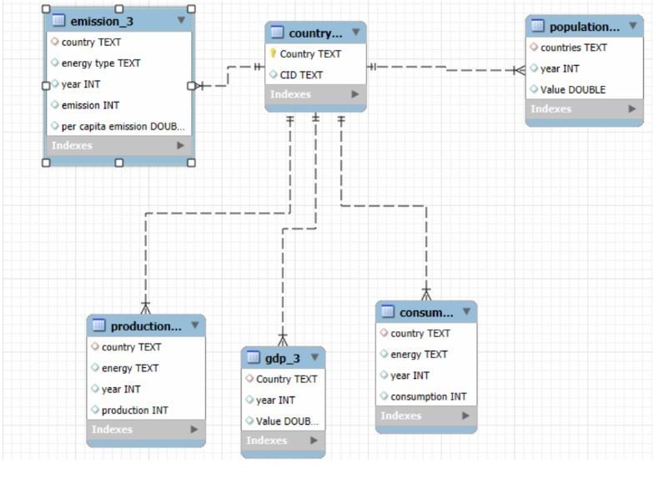
4. Database Structure & Schema Overview
Project ER diagram — the country table acts as the central reference
CENTRAL TABLE
country stores the master country list and provides the reference for the five analytical tables.
RELATIONSHIP
The schema shows one-to-many links from country to emission, population, production, GDP and consumption.
JOIN GRAIN
Country + year; energy type is added when comparing production and consumption.
WORLD WIDE ENERGY CONSUMPTION • SQL PROJECT
07

Slide 8
5. SQL Analysis Approach & Key Concepts
How the database is turned into comparable analytical views
01
Create & import
02
Relate tables
KEY SQL CONCEPTS
Create ENERGYDB2 and load the six CSV tables.
Use the country reference to connect subject tables.
JOIN
Combines related country/year records.
GROUP BY
Builds country, energy-type and year summaries.
03
Align grain
04
Aggregate
Match country/year and, when needed, energy type.
Summarize totals, averages and rankings for comparison.
AGGREGATES
SUM, AVG and MAX support scale and ranking.
05
Analyze change
06
Interpret
SUBQUERIES
Find the latest available year dynamically.
Use year-wise logic and LAG() to study movement over time.
Translate each analytical view into a meaningful project insight.
WINDOW FUNCTIONS
LAG compares a row with the prior year.
CTE
Breaks a multi-stage yearly analysis into a clear step.
WORLD WIDE ENERGY CONSUMPTION • SQL PROJECT
08

Slide 9
6. Key Analysis Questions / Use Cases
The 17 questions are organized into four analytical lenses
GENERAL & COMPARATIVE
TREND ANALYSIS
• Latest-year emissions by country
• Top countries by GDP
• Production vs consumption
• Energy types contributing most to emissions
• Global emissions year over year
• GDP trend by country
• Population growth alongside emissions
• Consumption changes for major economies
• Yearly per-capita emission change
RATIO & PER-CAPITA
GLOBAL COMPARISONS
• Emission-to-GDP ratio
• Consumption per capita
• Production per capita
• Energy consumption relative to GDP
• GDP growth vs production growth
• Top 10 population and emissions
• Per-capita emission improvement
• Global emission share
• Global yearly averages
WORLD WIDE ENERGY CONSUMPTION • SQL PROJECT
09

Slide 10
7. Analysis Area I — General & Comparative
What the analysis establishes before looking at change over time
LATEST-YEAR EMISSION SCALE
ECONOMIC BENCHMARKING
The project first identifies the most recent available year and compares total emissions across countries.
Business meaning: shows where the overall emission burden is concentrated.
The latest GDP year is used to establish a high-level benchmark of economic scale.
Business meaning: creates context for interpreting energy demand and emissions.
SUPPLY vs DEMAND
ENERGY-TYPE CONTRIBUTION
Production and consumption are aligned at country + energy + year grain.
Business meaning: highlights whether energy supply and demand move together.
Emissions are aggregated by energy type across all countries.
Business meaning: shows which energy categories are most important to the overall emission profile.
Interpretation principle: these analyses answer “How large?”, “Where?”, and “Which energy categories?” before deeper trend and ratio analysis.
WORLD WIDE ENERGY CONSUMPTION • SQL PROJECT
10

Slide 11
8. Analysis Area II — Trend Analysis
How the project studies direction and change across years
GLOBAL EMISSIONS
Year-wise total emissions reveal whether the global level is moving up or down over time.
GDP TREND
Country-level GDP history provides an economic timeline for comparison with energy activity.
POPULATION + EMISSIONS
Population growth is examined alongside emission changes to separate scale effects from intensity effects.
CONSUMPTION TREND
Major-economy consumption is compared year by year to identify sustained increases or decreases.
PER-CAPITA CHANGE
The yearly difference in per-capita emissions highlights direction of improvement or deterioration.
Analytical mechanism: year-wise aggregation + LAG() makes the change from the previous year explicit.
WORLD WIDE ENERGY CONSUMPTION • SQL PROJECT
11

Slide 12
9. Analysis Area III — Ratios, Per-Capita & Global Views
Normalization and global context make cross-country comparisons more meaningful
NORMALIZED METRICS
GLOBAL COMPARISONS
• Emission-to-GDP ratio — relates environmental burden to economic output.
• Consumption per capita — adjusts energy demand for population size.
• Production per capita — compares energy supply on a population-adjusted basis.
• Consumption relative to GDP — links energy demand to economic scale.
• Compare the most populous countries with their total emissions.
• Track changes in per-capita emissions over the last decade.
• Calculate each country’s share of global emissions.
• Summarize yearly global averages for GDP, emissions and population.
HOW TO READ THE RESULTS
Totals show overall scale. Per-capita metrics show population-adjusted intensity. GDP ratios add an economic denominator. Global shares show how much of the total is associated with each country. Together, these views reduce the risk of interpreting a country from only one metric.
WORLD WIDE ENERGY CONSUMPTION • SQL PROJECT
12

Slide 13
10. Conclusion, Challenges & Future Improvements
Overall learning from the project and how the analysis can be extended
CONCLUSION
CHALLENGES FACED
FUTURE IMPROVEMENTS
• Six related tables create a unified energy–economy–population–emissions view.
• The project moves from raw records to comparisons, trends and normalized measures.
• The key value of SQL is the reasoning: choose the correct grain, relationship, aggregation and metric for each question.
• Multiple valid SQL approaches can answer the same question.
• Country and year alignment must remain consistent across tables.
• Totals, ratios and per-capita metrics answer different types of questions.
• The presentation must explain the meaning of results, not just show SQL.
• Connect the database to Power BI for interactive exploration.
• Add data-quality checks for missing and duplicate country-year records.
• Extend analysis by region and renewable/non-renewable categories.
• Automate data refreshes and optimize frequent joins with indexes/views.
Overall takeaway: the project demonstrates how SQL can connect multiple dimensions of energy data and turn them into a structured analytical story.
WORLD WIDE ENERGY CONSUMPTION • SQL PROJECT
13

Slide 14

THANK YOU
Questions & Discussion
World Wide Energy Consumption
SQL Project
Kumar Pradeep• CSE • 2023–2027
WORLD WIDE ENERGY CONSUMPTION • SQL PROJECT
14

